Slide 1
Introduction to HUB & software
BY SANJAY AND ARVIND SESHAN

Slide 2
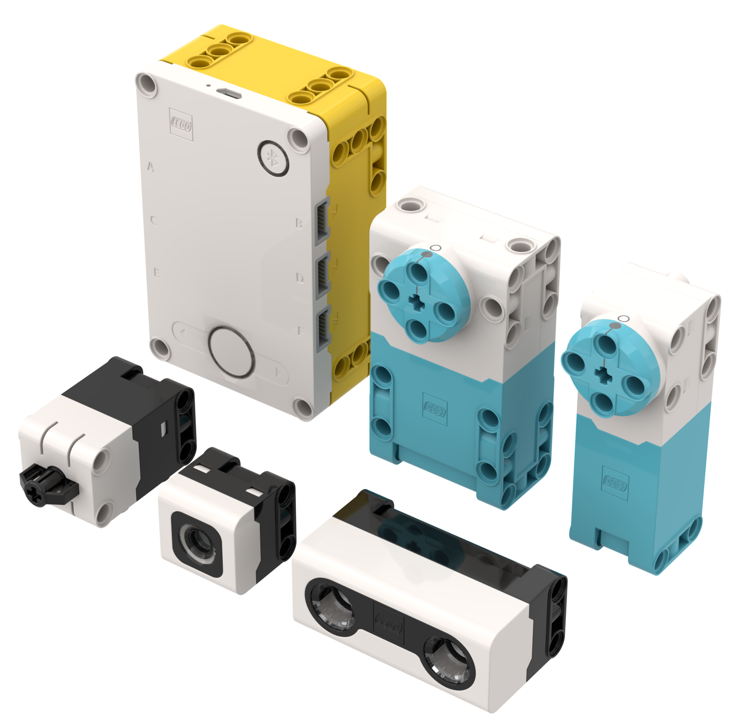
Lesson Objectives
Learn how the SPIKE Prime Hub operates
Learn about the main components of the SPIKE Prime Software
Learn how to connect your Hub

Slide 3
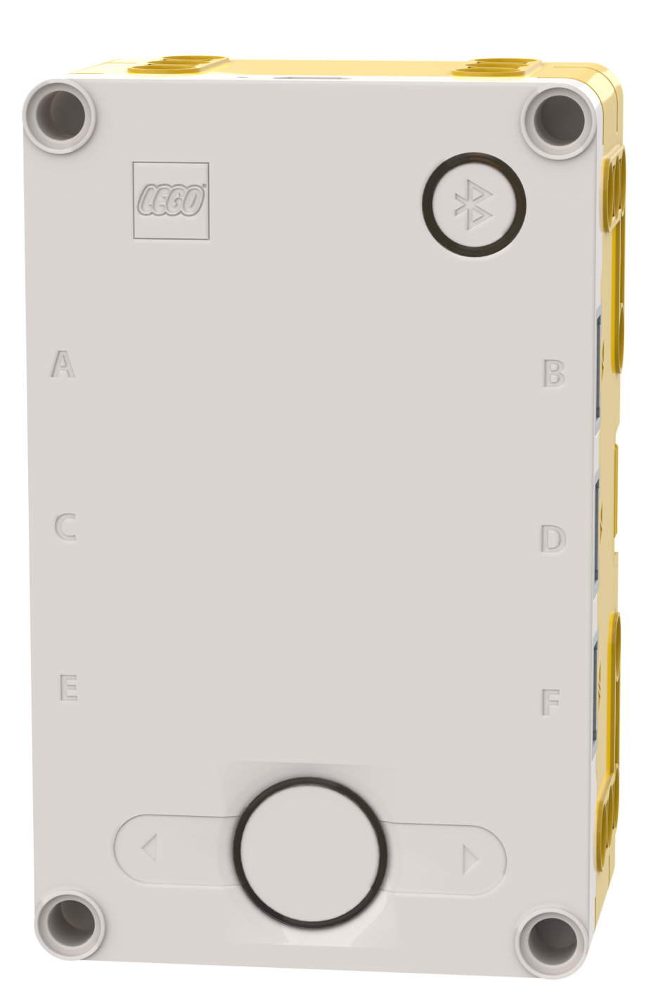
The Hub Buttons
Put Hub in Bluetooth pairing mode
Left button for program navigation in home menu
Select program or exit program when running. Hold down for 5 seconds to power off. Turns on Hub.
Right button for program navigation
1
3
2
4

Slide 4
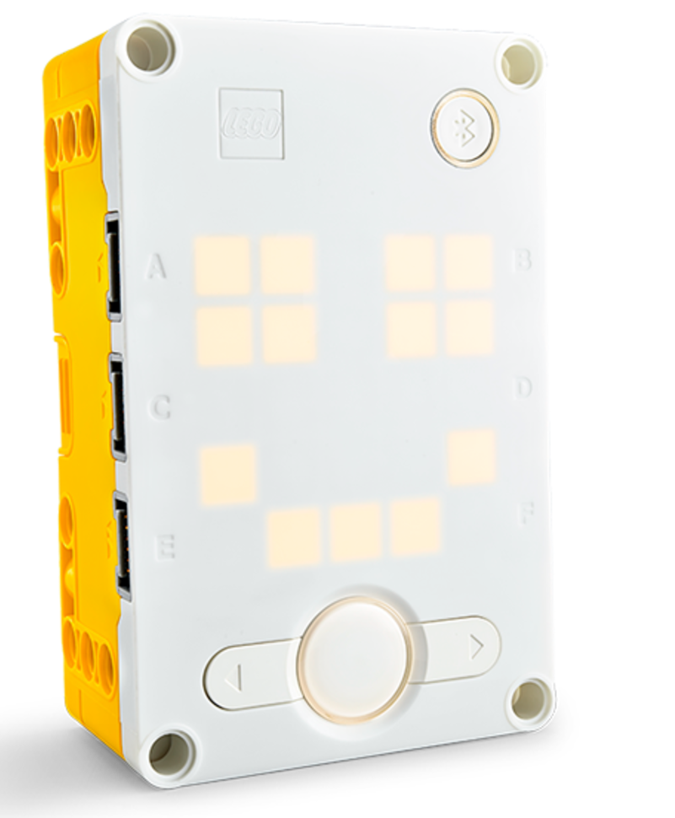
The Hub screen
5x5 LED pixel matrix can be used to make designs, but also pick programs
Patterns onscreen represent different programs
Use the arrows and center button to navigate/launch programs
You can have a maximum of 20 programs

Slide 5
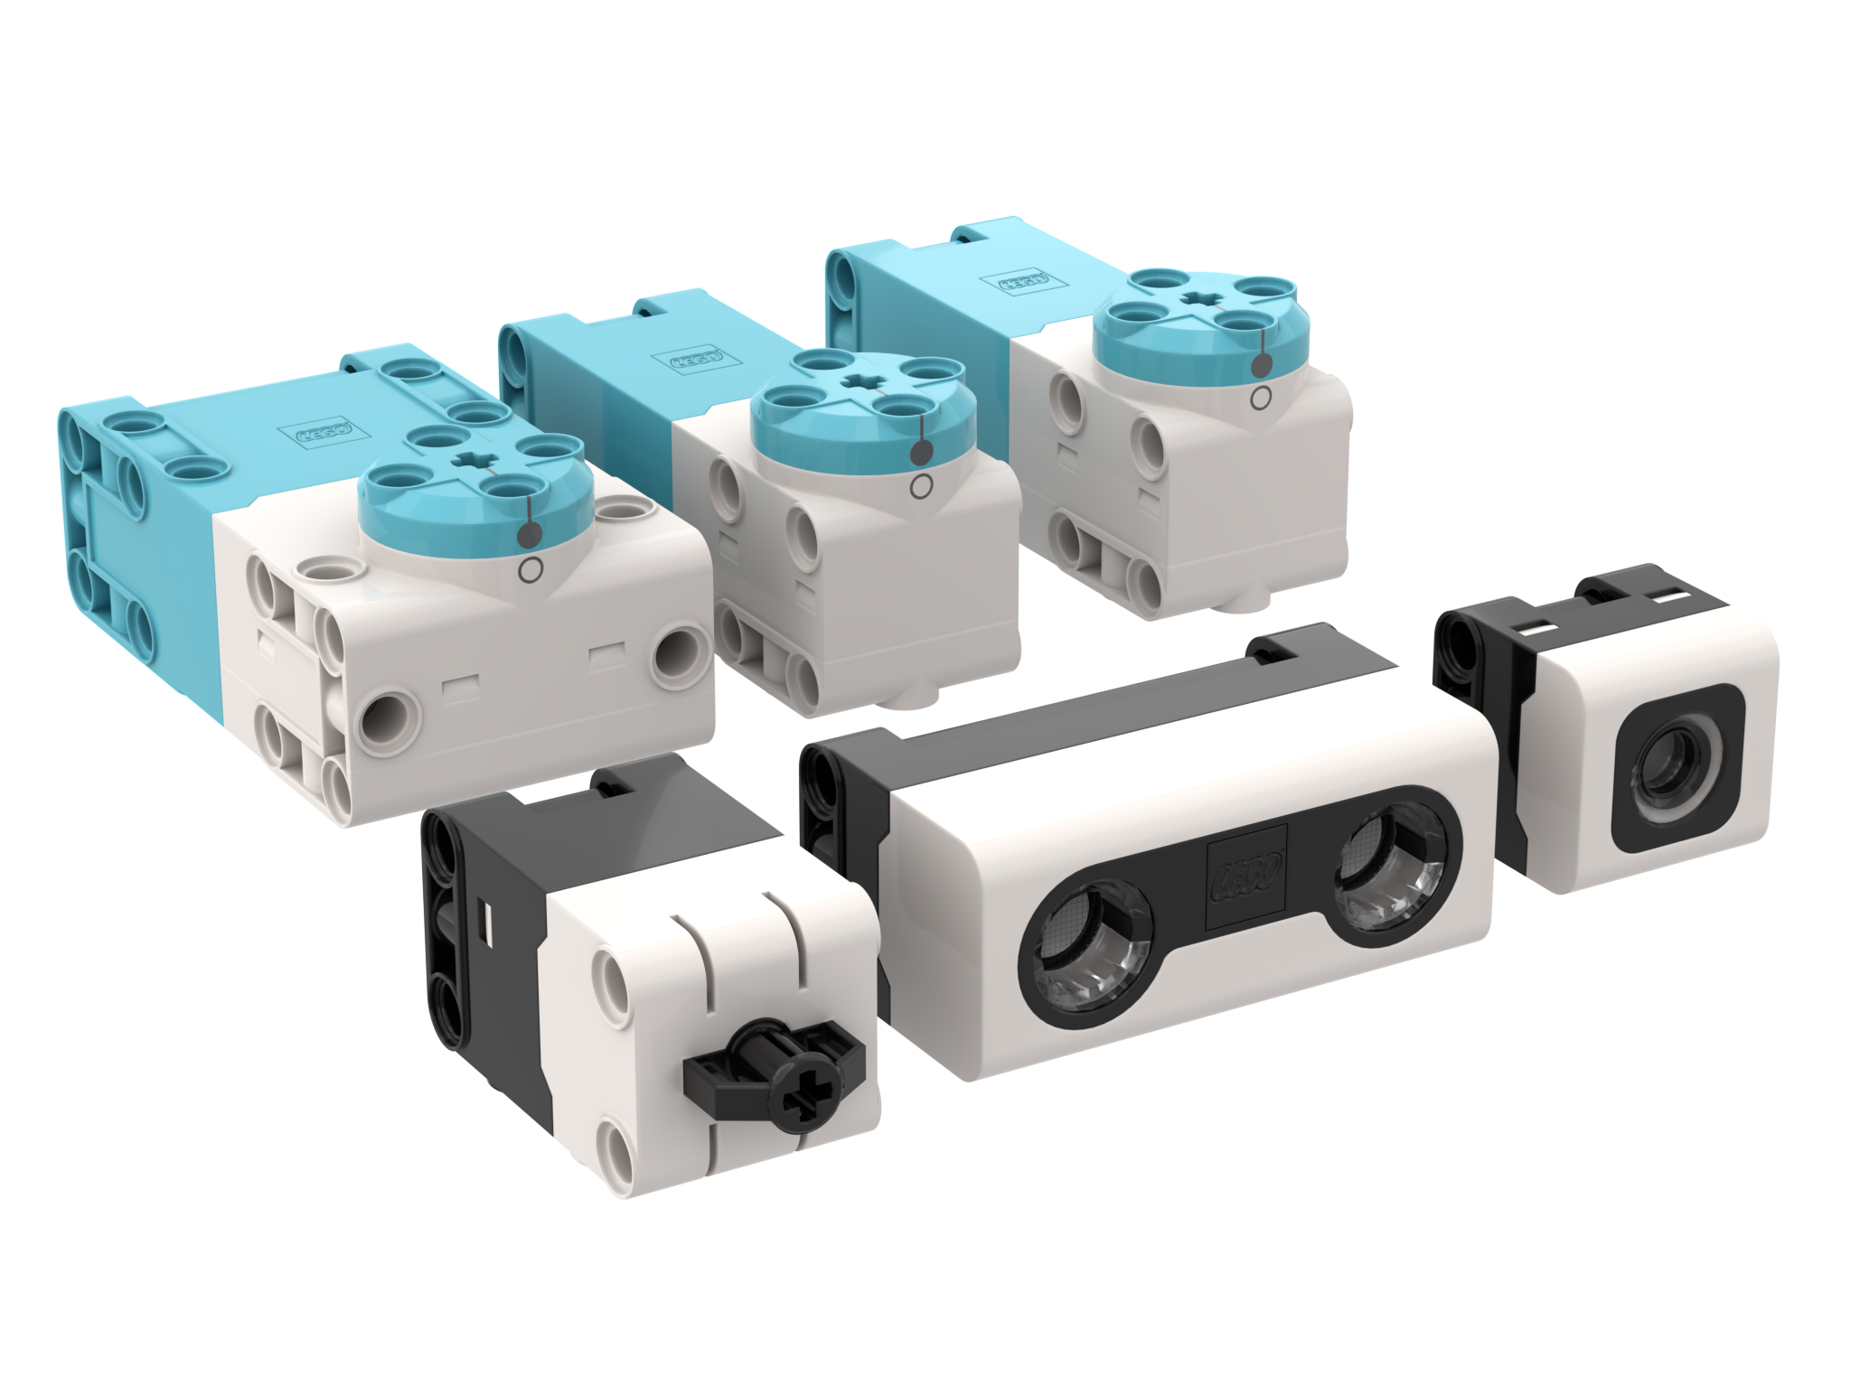
Ports, Motors and sensors
The hub has 6 built-in ports (A-F)
Any port can be used for any motor or sensor
The basic SPIKE PRIME set comes with 1 Large Motor and 2 Medium Motors, 1 Force Sensor, 1 Distance Sensor, 1 Color Sensor, and a built-in 6-axis IMU (3-axis accelerometer + 3-axis gyro)

Slide 6
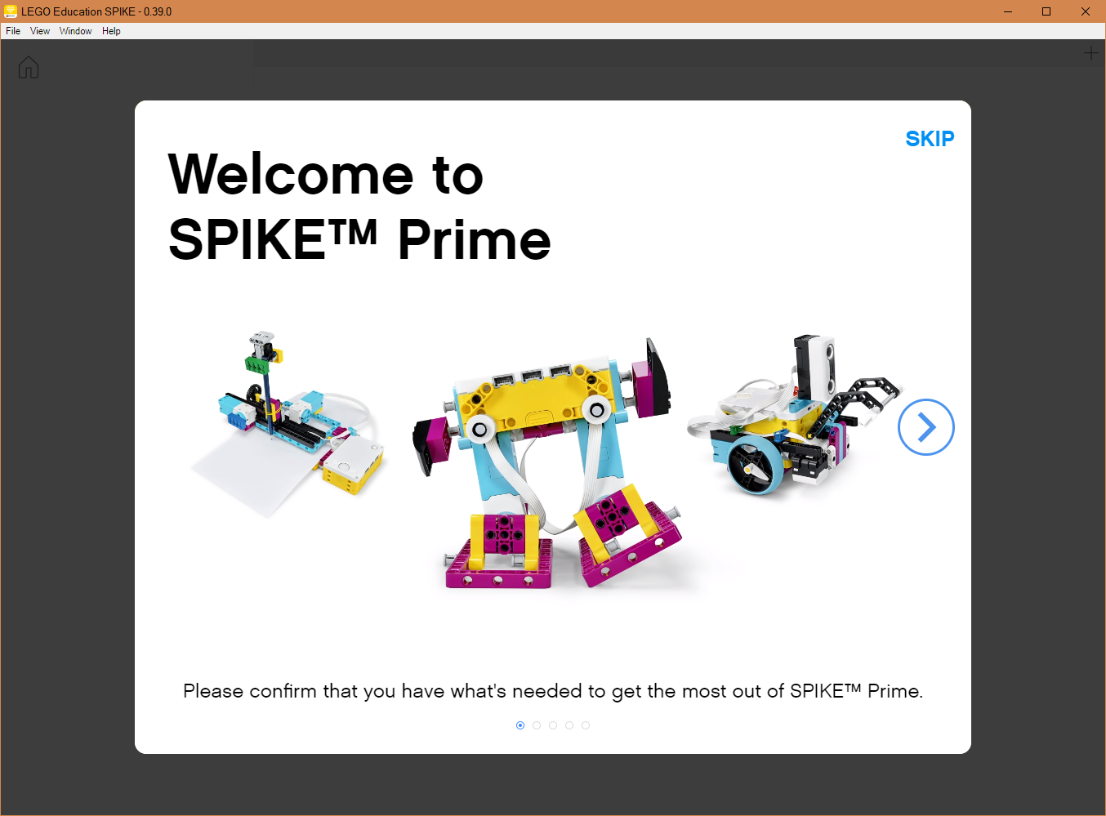
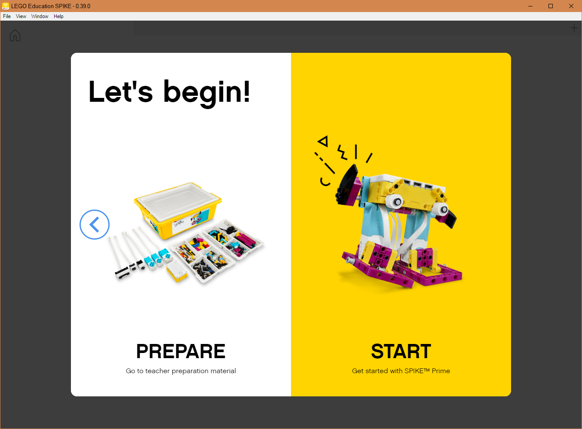
Getting Started
Follow the onscreen steps and then click “START” to access the programming environment

Slide 7
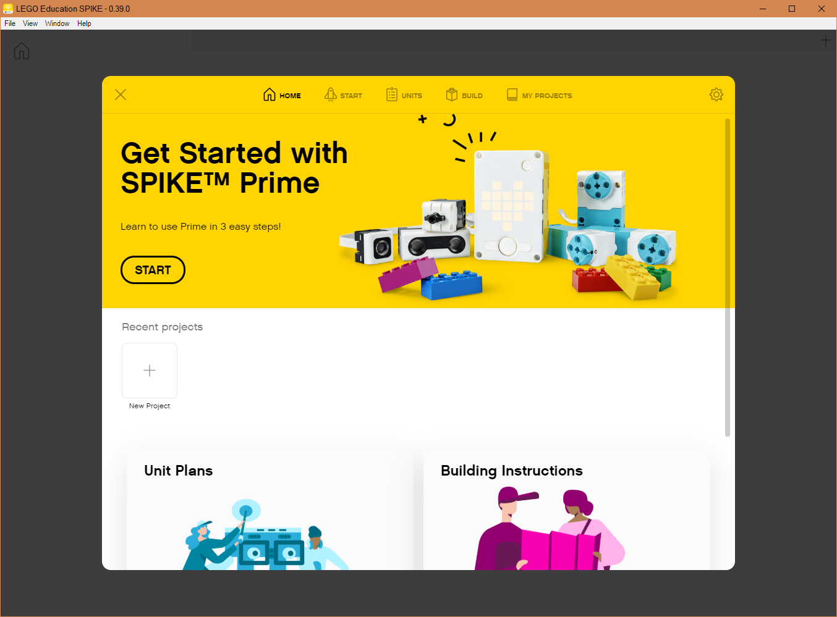
HOME MENU
Adding Curriculum
Build Instructions
Open Saved Project
Create New Project

Slide 8
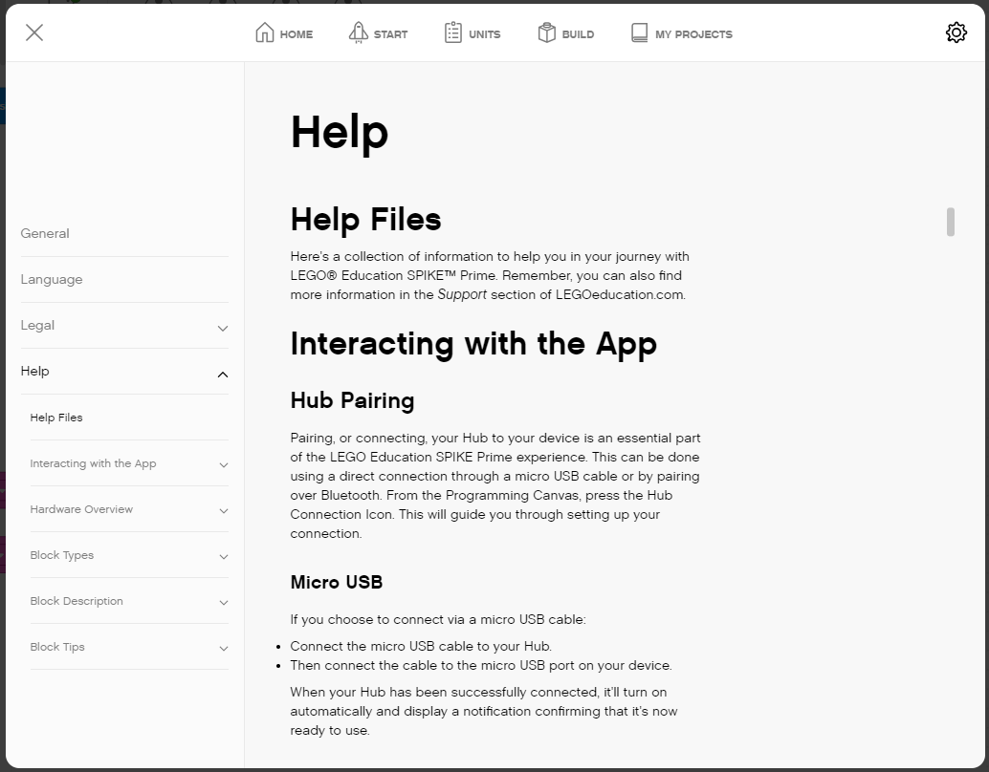
Accessing the HELP MENU
Click the Settings icon in the Home screen
Navigate to Help on the left hand column

Slide 9
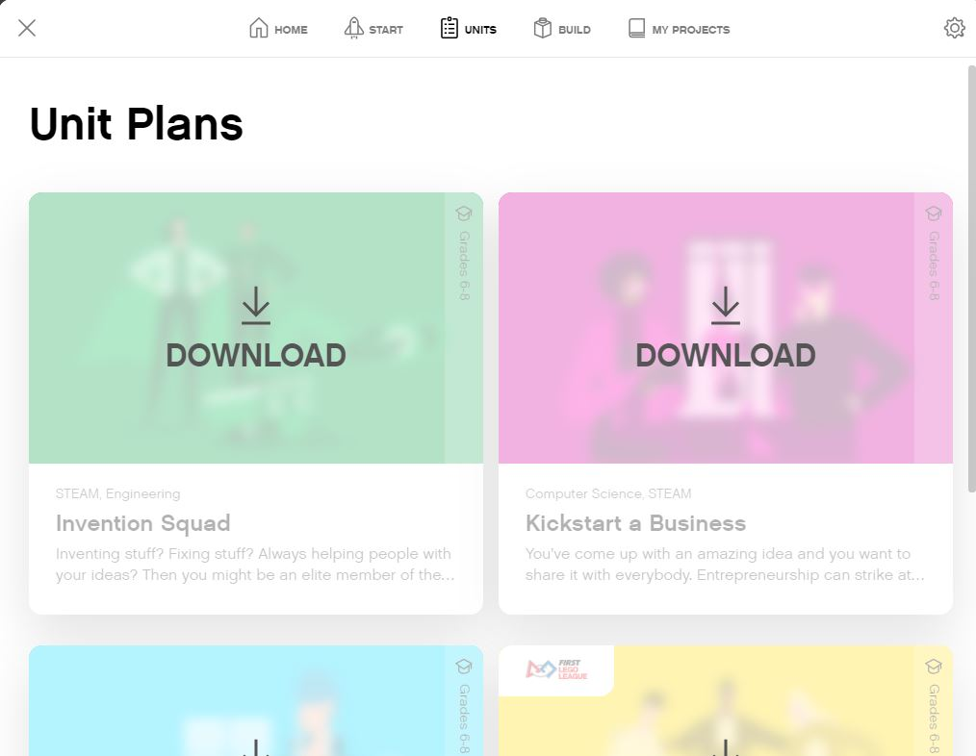
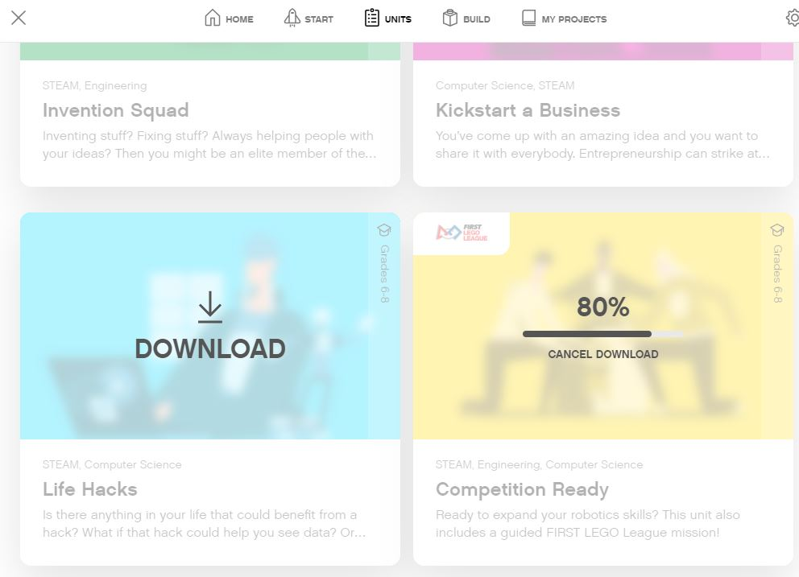
ADDING CURRICULUM - UNITS
Lesson Plans can be found in the Units Section from the Home Menu.
Section which unit you want to add and hit Download
The FIRST LEGO League Curriculum is called “Competition Ready’

Slide 10
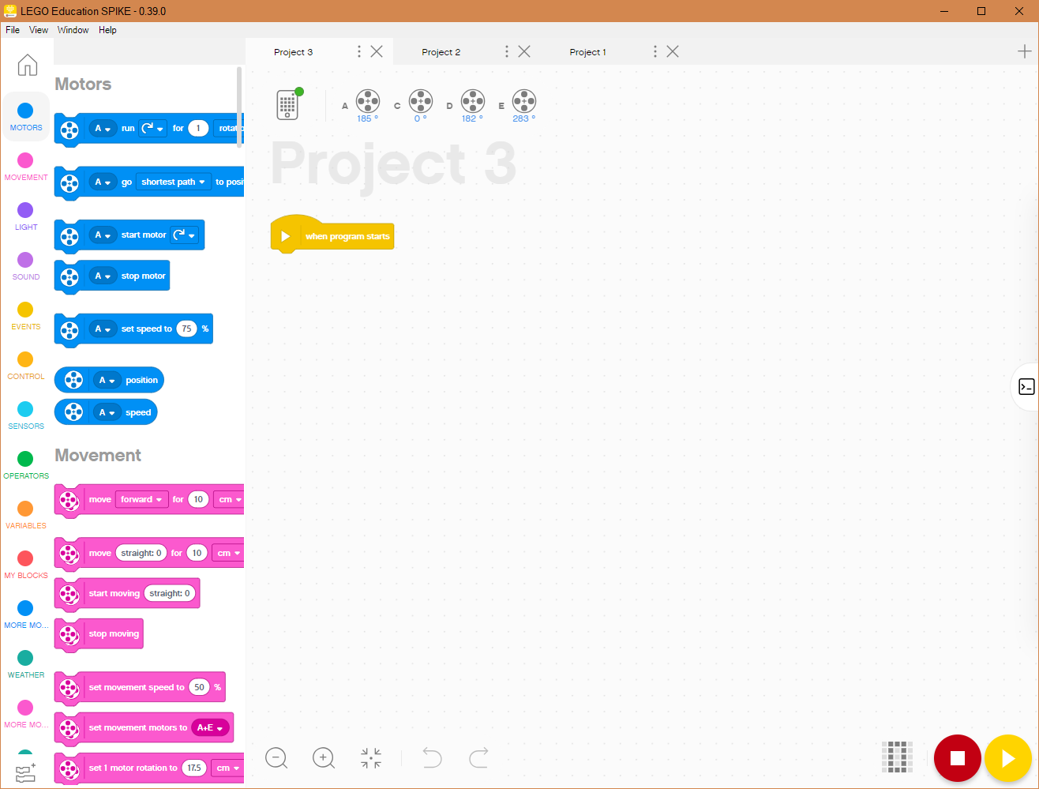
Programming Canvas Essentials
Back to Home
New Project
Project Properties Rename Project or Move File to new location (i.e. Save as)
Opened Project
Programming Canvas
Extensions

Slide 11
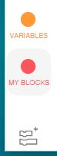
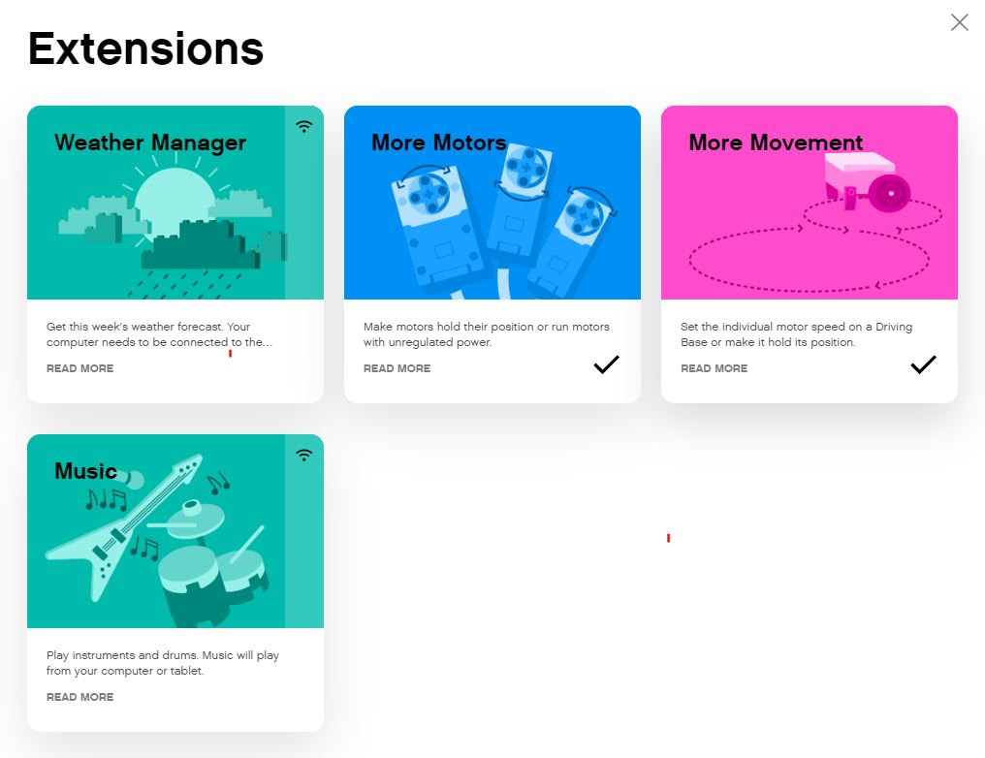
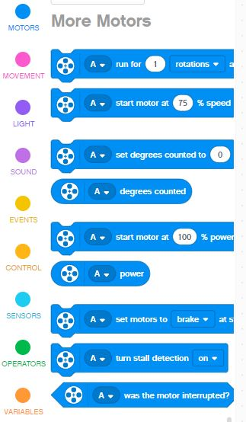
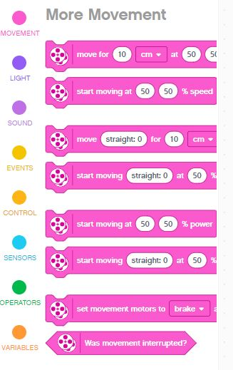
EXTENSIONS: ADDING MORE BLOCKS
When you open the software, not all available blocks are enabled.
Click on the Extensions icon at the bottom of the Block Palette panel
In our lessons, we will use “More Motors” and “More Movement” often
These blocks will show up as separate tabs in the programming palette once downloaded.

Slide 12
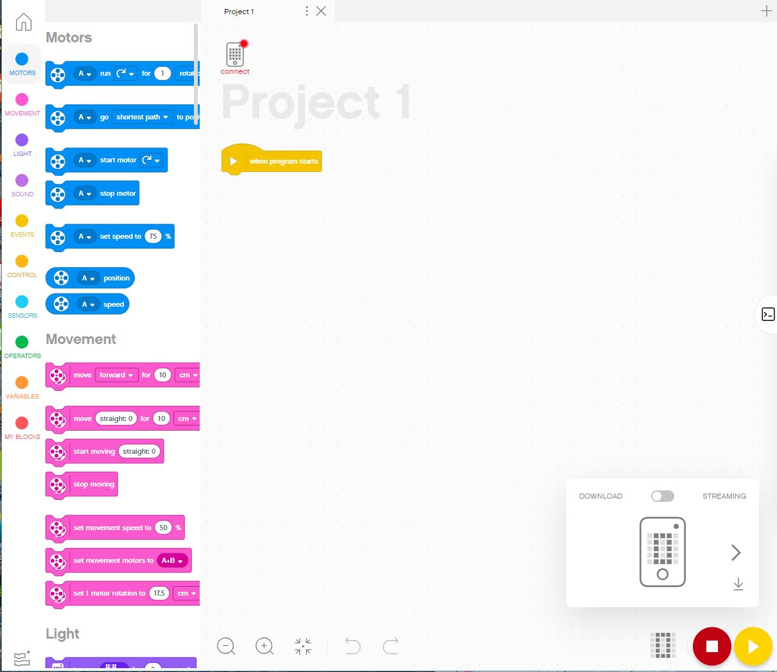
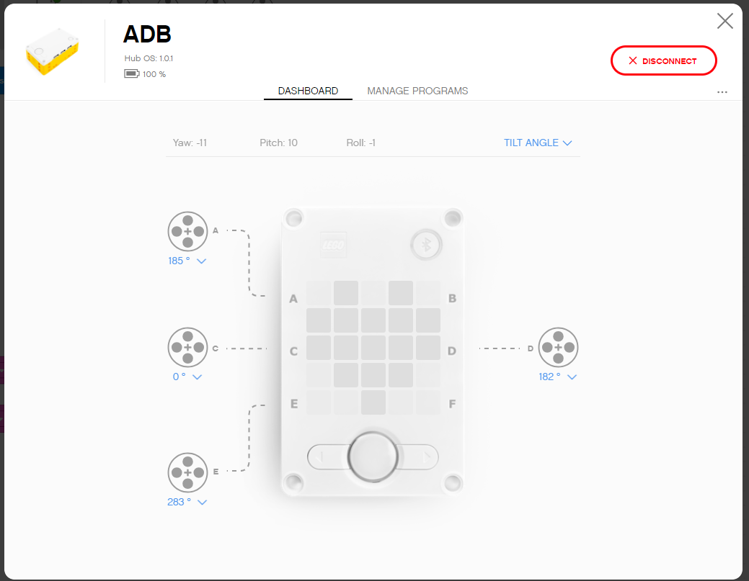
Programming Canvas
Block Palette
The main programming canvas is where you will create each program (called ‘Project’)
All the programming blocks are on the Block pallet on the left
The Connect Icon lets you access the Hub Dashboard
The Download/Run Icon lets you pick the mode to download
Hub Dashboard
Download
Download
Stop and Play

Slide 13
BLOCK PALETTE OVERVIEW
Motors – Control an individual motor
Movement – Control two motors at a time with synchronization
Light – Program the 5X5 matrix
Sound – Play a sound
Events – Run actions based on events (e.g. sensor or timer)
Control – Loops, if/else statements, etc.
Sensors – Read a sensor value
Operators – Mathematics and logic
Variables – Store data in a variable or list
My Blocks – Custom defined blocks
More Movement – Additional movement blocks
More Motors – Additional motor blocks
Weather – Access weather information and forecasts
Music – Play musical notes and select instruments

Slide 14
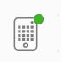
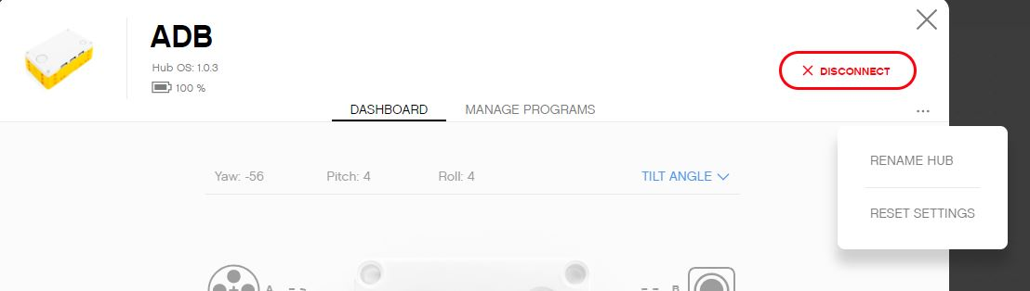
HUB DASHBOARD
You must connect your Hub to access this section
This section is very useful for:
Checking battery level
Hub OS version
Gyro Sensor Values
See which motors and sensors are connected
Get real time values from the motors and sensors
You can also rename your Hub in this panel by clicking on the three dots (…)
The Manage Programs has a list of all programs on the Hub (maximum of 20). Use this section to change the order of the programs.

Slide 15
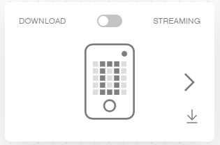
Download vs. streaming mode
Download: The program runs on the hub and can be run at any time with or without your PC
Streaming: The program runs on your PC and controls the robot’s motors
This tends to cause slower response times for the robot, but it allows you to use IOT (Internet of Things) features, such as weather readings
Note: FIRST LEGO League Teams must use Download mode in competition

Slide 16
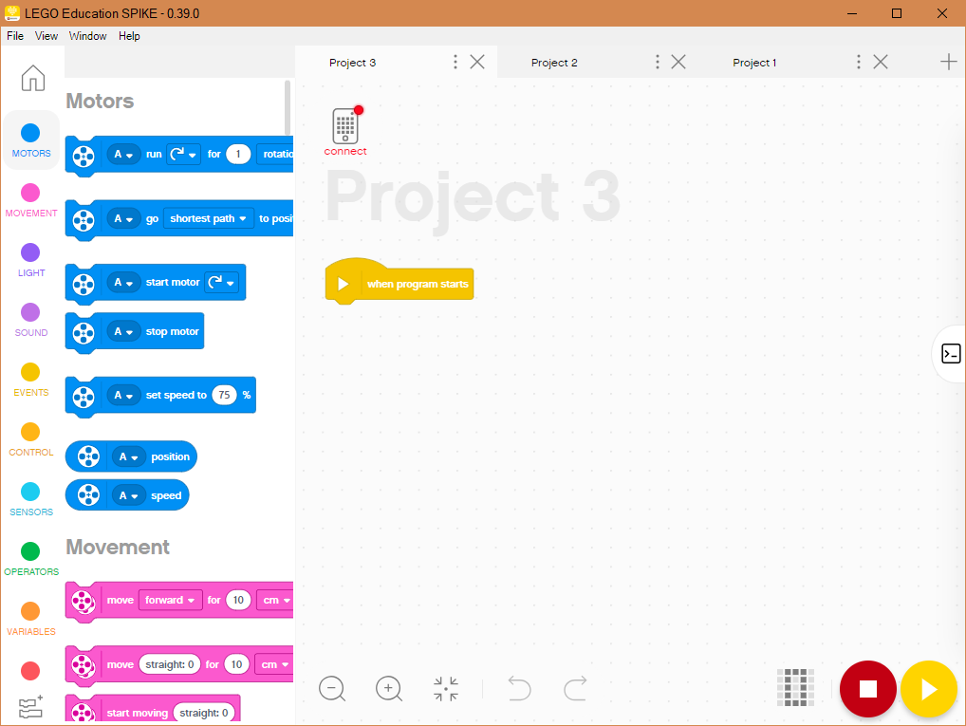
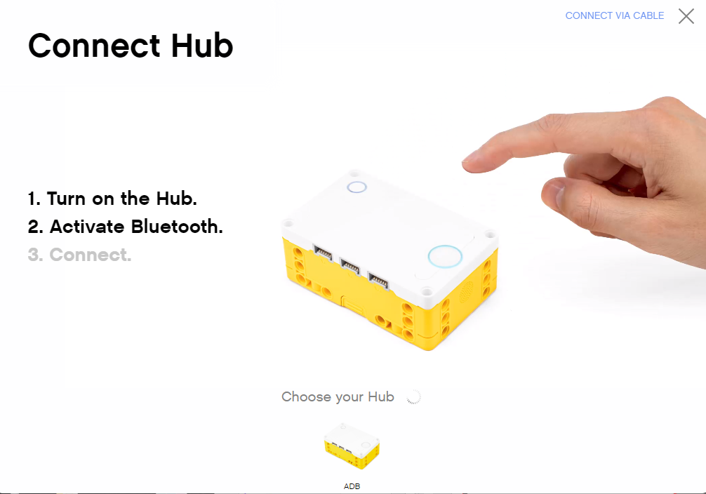
Connecting to brick
The software will auto-connect to the brick if you are using USB
To connect over Bluetooth, click the connect icon in the software.
Enable Bluetooth by pressing the Bluetooth button on the brick.
Your brick will show up in the list at the bottom. Click connect on your hub

Slide 17
CREDITS
This lesson was created by Sanjay Seshan and Arvind Seshan for SPIKE Prime Lessons
More lessons are available at www.primelessons.org
This work is licensed under a Creative Commons Attribution-NonCommercial-ShareAlike 4.0 International License.

